Slide 1
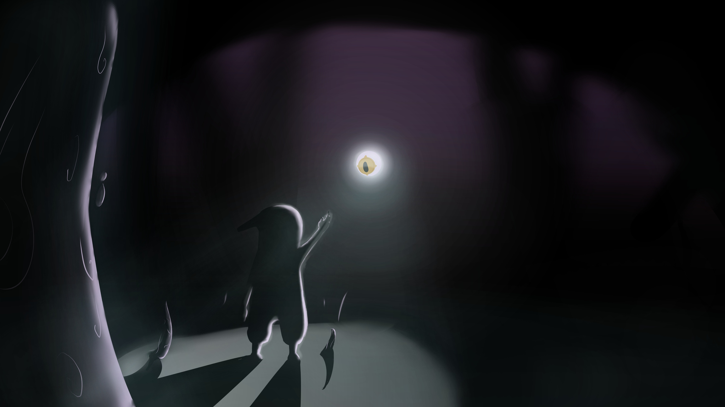



Shadow & Eye
What if the human mind was a deep, intricate eco-system, with every aspect having a physical form and the hard fought battles inside will take place right in-front of your eyes?
Shadow & Eye is a 2D Metroidvania where not only do you fight inner demons, but you ARM yourself with them.
Developers:
Daniel Fradkin
Or Bar-Califa
Animators:
Naor Masri
Majd Francis
Mentoring by Ella Luna Pleasence

Slide 2
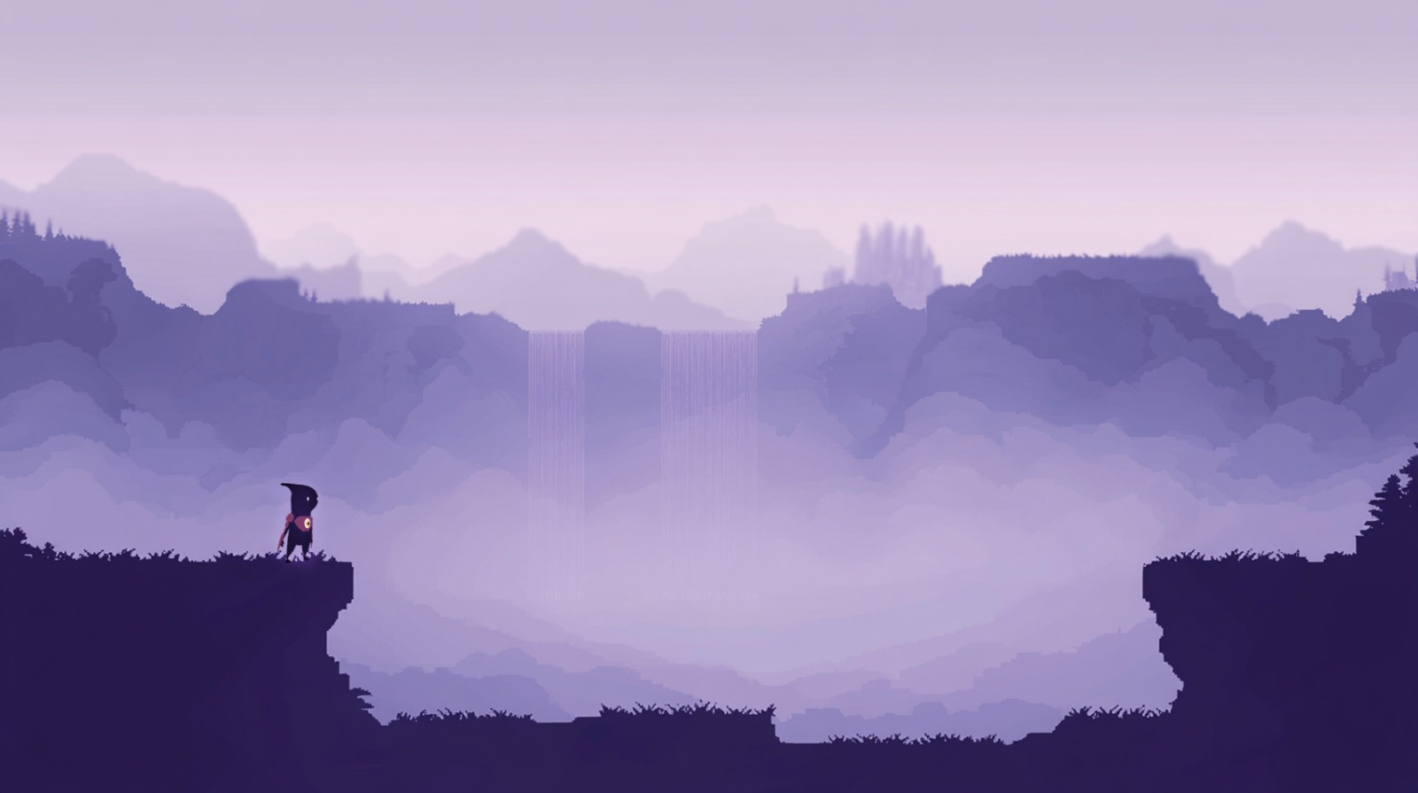
The concept
As a disaster falls upon this world, at you feet arrives “The Eye” - an all-seeing entity, removed and banished from its place.
your mission is to return it to its place and bring this world back to health.
In order to traverse this unforgiving land, The Eye grants you the power to wear the shells of the enemies you defeat - ”Maluvestis”, to beat even stronger foes and reach remarkable hights.
Genre & Loop: 2D platformer → explore → combat → unlock suits → overcome challenges

Slide 3

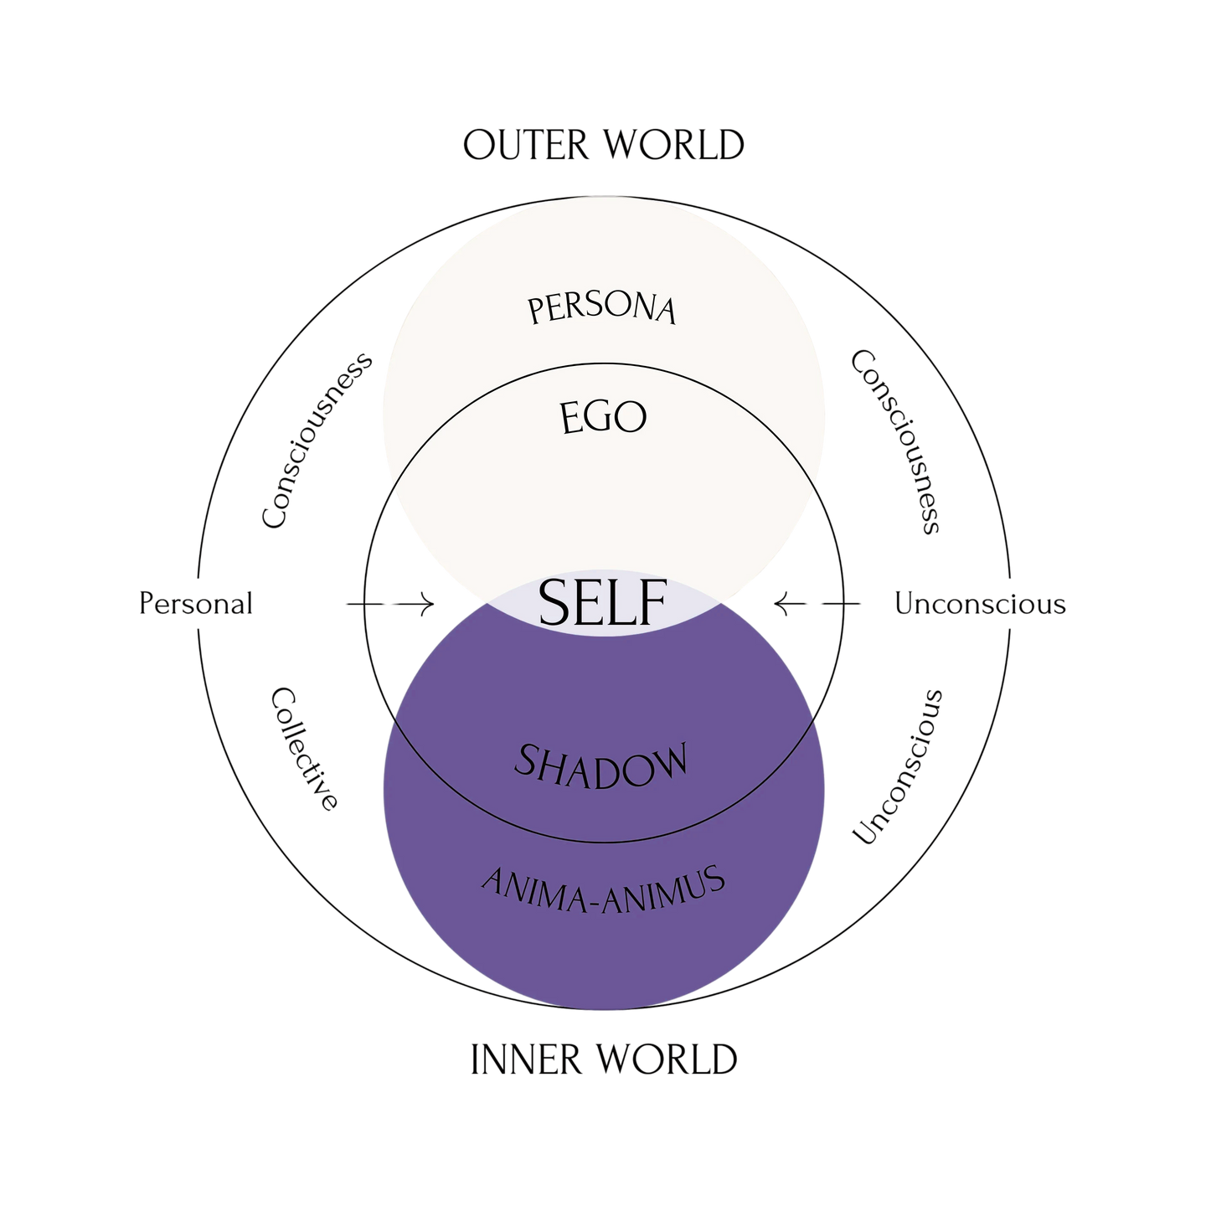



The Theory
THE game
REVELIS
VERONA
VEGO
THE EYE
ADO
EBBA & IMMUS
CALIGOTH

Slide 4
Project Goals
Flexible Power System: Easily add new enemy powers. Support diverse playstyles.
Smooth Combat & Movement: Impactful abilities; fluid tactical adaptation.
Maintainable Code: Smart structure for future expansion.
Tech Stack: Unity (2022 LTS), C#, URP, Input System, A* Pathfinding.
Aim: Fun game exploring self-discovery & inner challenges.
Goal: Engaging adventure, subtly thought-provoking.
Mechanics as Metaphors:
New Powers: Learning from challenges.
Enemies: Internal hurdles.
Game Areas: Three big areas representing the different aspects of the mind.

Slide 5
Philosophy: Fun with a Deeper Meaning
Aim: Mechanics as Metaphors:
New Powers: Learning from challenges.
Enemies: Internal hurdles.
Game Areas: Three big areas representing the different aspects of the mind.
Goal: Engaging adventure, subtly thought-provoking.
[IMAGE: Abstract art that feels a bit introspective, or a character looking thoughtfully at different paths]
Notes:
Speaker Notes: (You'll deliver this verbally) Our main goal was to make a really fun Metroidvania that also touches on deeper ideas like self-discovery. So, when you get new powers, it's kind of like growing from challenges. The enemies are like those internal struggles, and the different game areas are like different moods. We wanted it to be an adventure that makes you think a bit, but mostly is just fun to play.

Slide 6
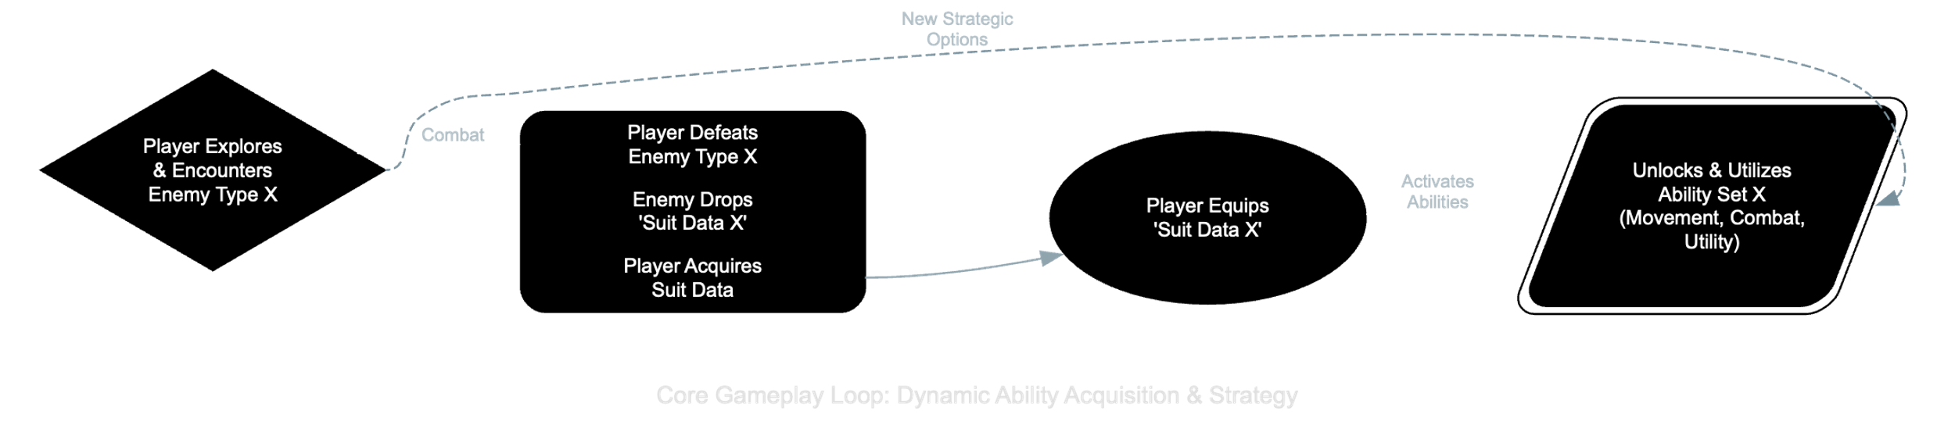
Project Goals: Building a Cool & Flexible Game
Fun game exploring self-discovery & inner challenges
Flexible Power System:
Easily add new enemy powers
Support diverse playstyles
Smooth Combat & Movement:
Impactful abilities; fluid tactical adaptation
Maintainable Code:
Smart structure for future expansion.
Tech Stack: Unity (2022 LTS), C#, URP, Input System, A* Pathfinding.
[IMAGE/GIF: Player using a couple of very different powers]
Notes:
Speaker Notes: (You'll deliver this verbally) Tech-wise, our main goals were a super flexible power-up system – so we could easily add new abilities from enemies without rewriting tons of code. We also wanted combat and movement to feel really smooth and let players adapt. And, of course, write code that's easy to manage and expand. We built it all in Unity, using C#, URP for graphics, the new Input System, and A* for enemy pathfinding.

Slide 7
Technology
Algorithms
Unity engine and tools:
unity engine provide physics and the basic enviorment
A* Project - to provide points and paths
cinemachine- To create a dynamic camera according to size of room
enemy Ai useing state machine to give diffrent and smarter behivors
new input system for a wild range of controllers
A* Project - to provide points and paths
enemy Ai useing state machine to give diffrent and smarter behivors

Slide 8
Architecture
InputSystem
singletons for managers like level manager
state machine that handles events and updates based on player input and actions using state pattrn
beacon using mediator pattern to prevent dependencies and reduce capaling
dedicated scripts for specific action to provide a clear structure and orignition
event based architecture to reduce capulin
using abstract classes to facilitate generic interfaces
Loose coupling via ScriptableObject events
[InputSystem] → [MovementModule] → [PhysicsEngine]
↘ ↗
[SuitManager] ↔ [CombatModule] → [Animator]
↘ ↗
[EnemyAI (FSM + ML-Agents)]

Slide 9
Dynamic Suit System
Strategy Pattern: abstract SuitAbility.ExecuteAbility()
Data-Driven: parameters in ScriptableObjects (cooldownTime, effectRadius)
Event Hooks: C# events/UnityEvents for OnEquip/OnUnequip
Extensibility: add new suits without touching core code

Slide 10
The Tough Parts: Making it All Happen
Many Powers: Managing ability complexity without messy code.
Quick Power Swaps: Ensuring natural, intuitive control.
Thematic Mechanics: Connecting powers/enemies to game themes.
System Interplay: Independent yet coordinated game parts.
[IMAGE: A question mark icon or a lightbulb icon]
Notes:
Speaker Notes: (You'll deliver this verbally) Of course, we hit some challenges. Like, how do we manage all these unique player powers without the code getting super messy? How do we make switching between powers feel good? How do we make sure the game mechanics actually connect to our deeper themes? And how do we get all the different parts of the game to talk to each other without creating a tangled web?

Slide 11
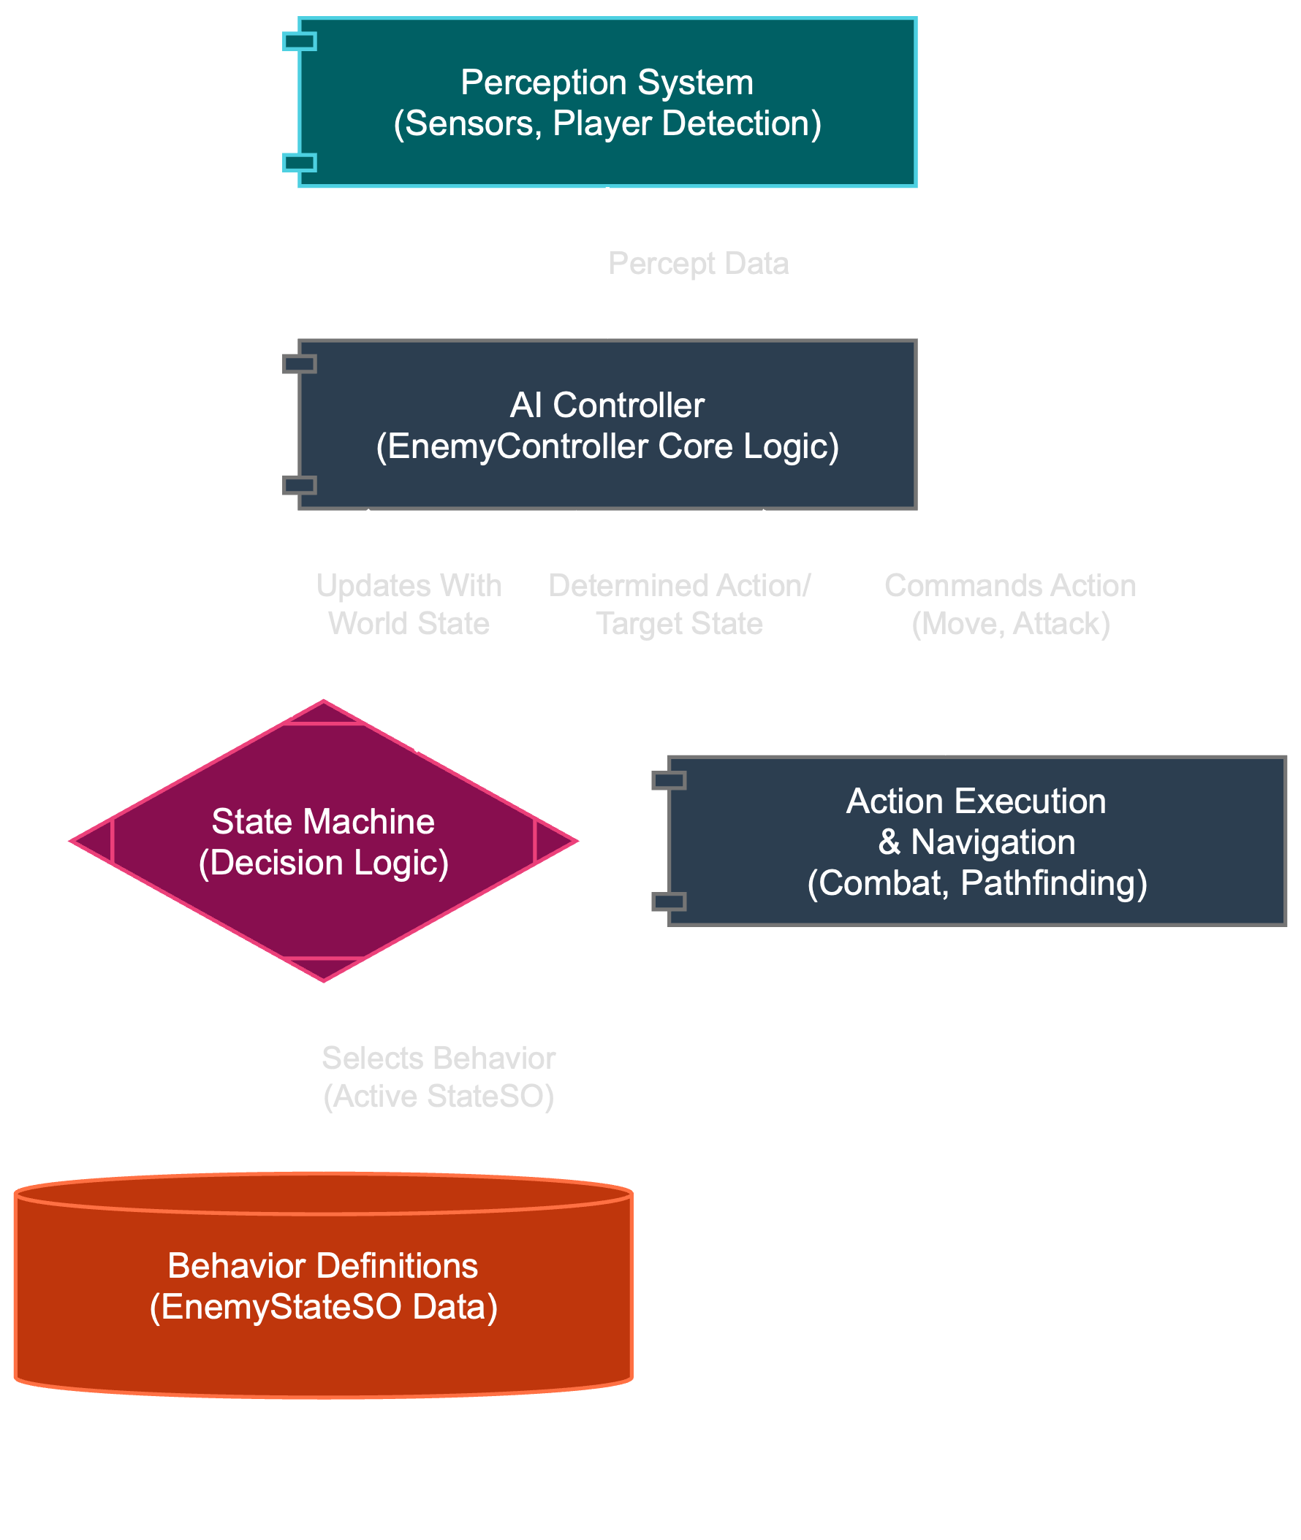
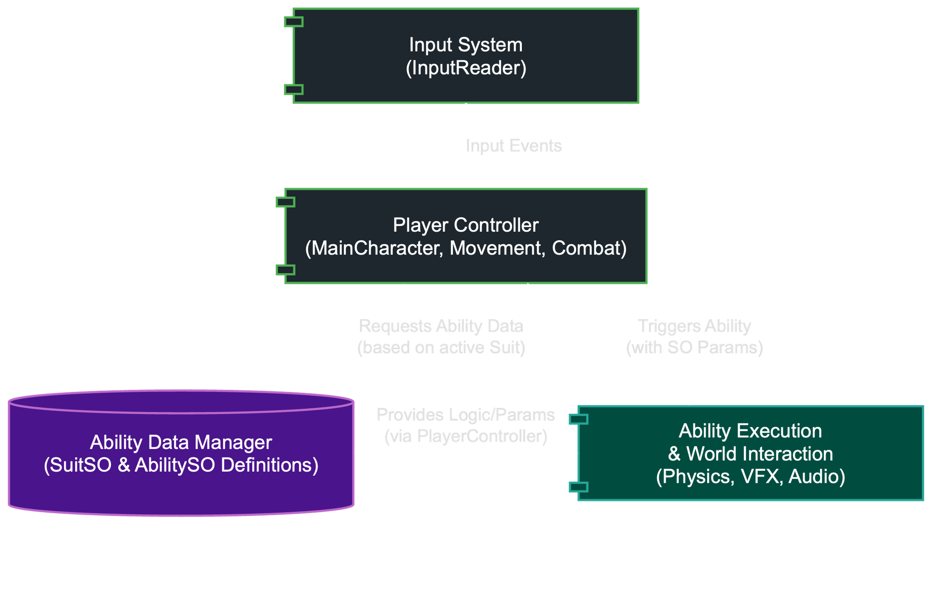
How We Solved It (Part 1): Smart Data & Key Patterns
Foundation: Unity Component-Based Design.
#1: ScriptableObjects (SOs) - Data-Driven Design:
Powers & Enemy AI defined as data files (SOs).
New Power/Enemy = New Data, not new complex code.
Benefit: Flexible, easy iteration, thematic integration.
#2: Strategy Pattern (Player Powers):
Player swaps "game plans" (power sets) from absorbed essences.
Benefit: Fluid playstyle changes.
Notes:
Speaker Notes: (You'll deliver this verbally) So here's how we tackled those challenges. Our main trick was using ScriptableObjects a LOT. Think of these as data files that tell the game how abilities work or how enemies should behave. This means adding a new power is mostly like adding a new data file, not rewriting a bunch of code. For player powers, we used the Strategy pattern – which just means the player can easily swap their 'game plan' based on the enemy power they're using.

Slide 12
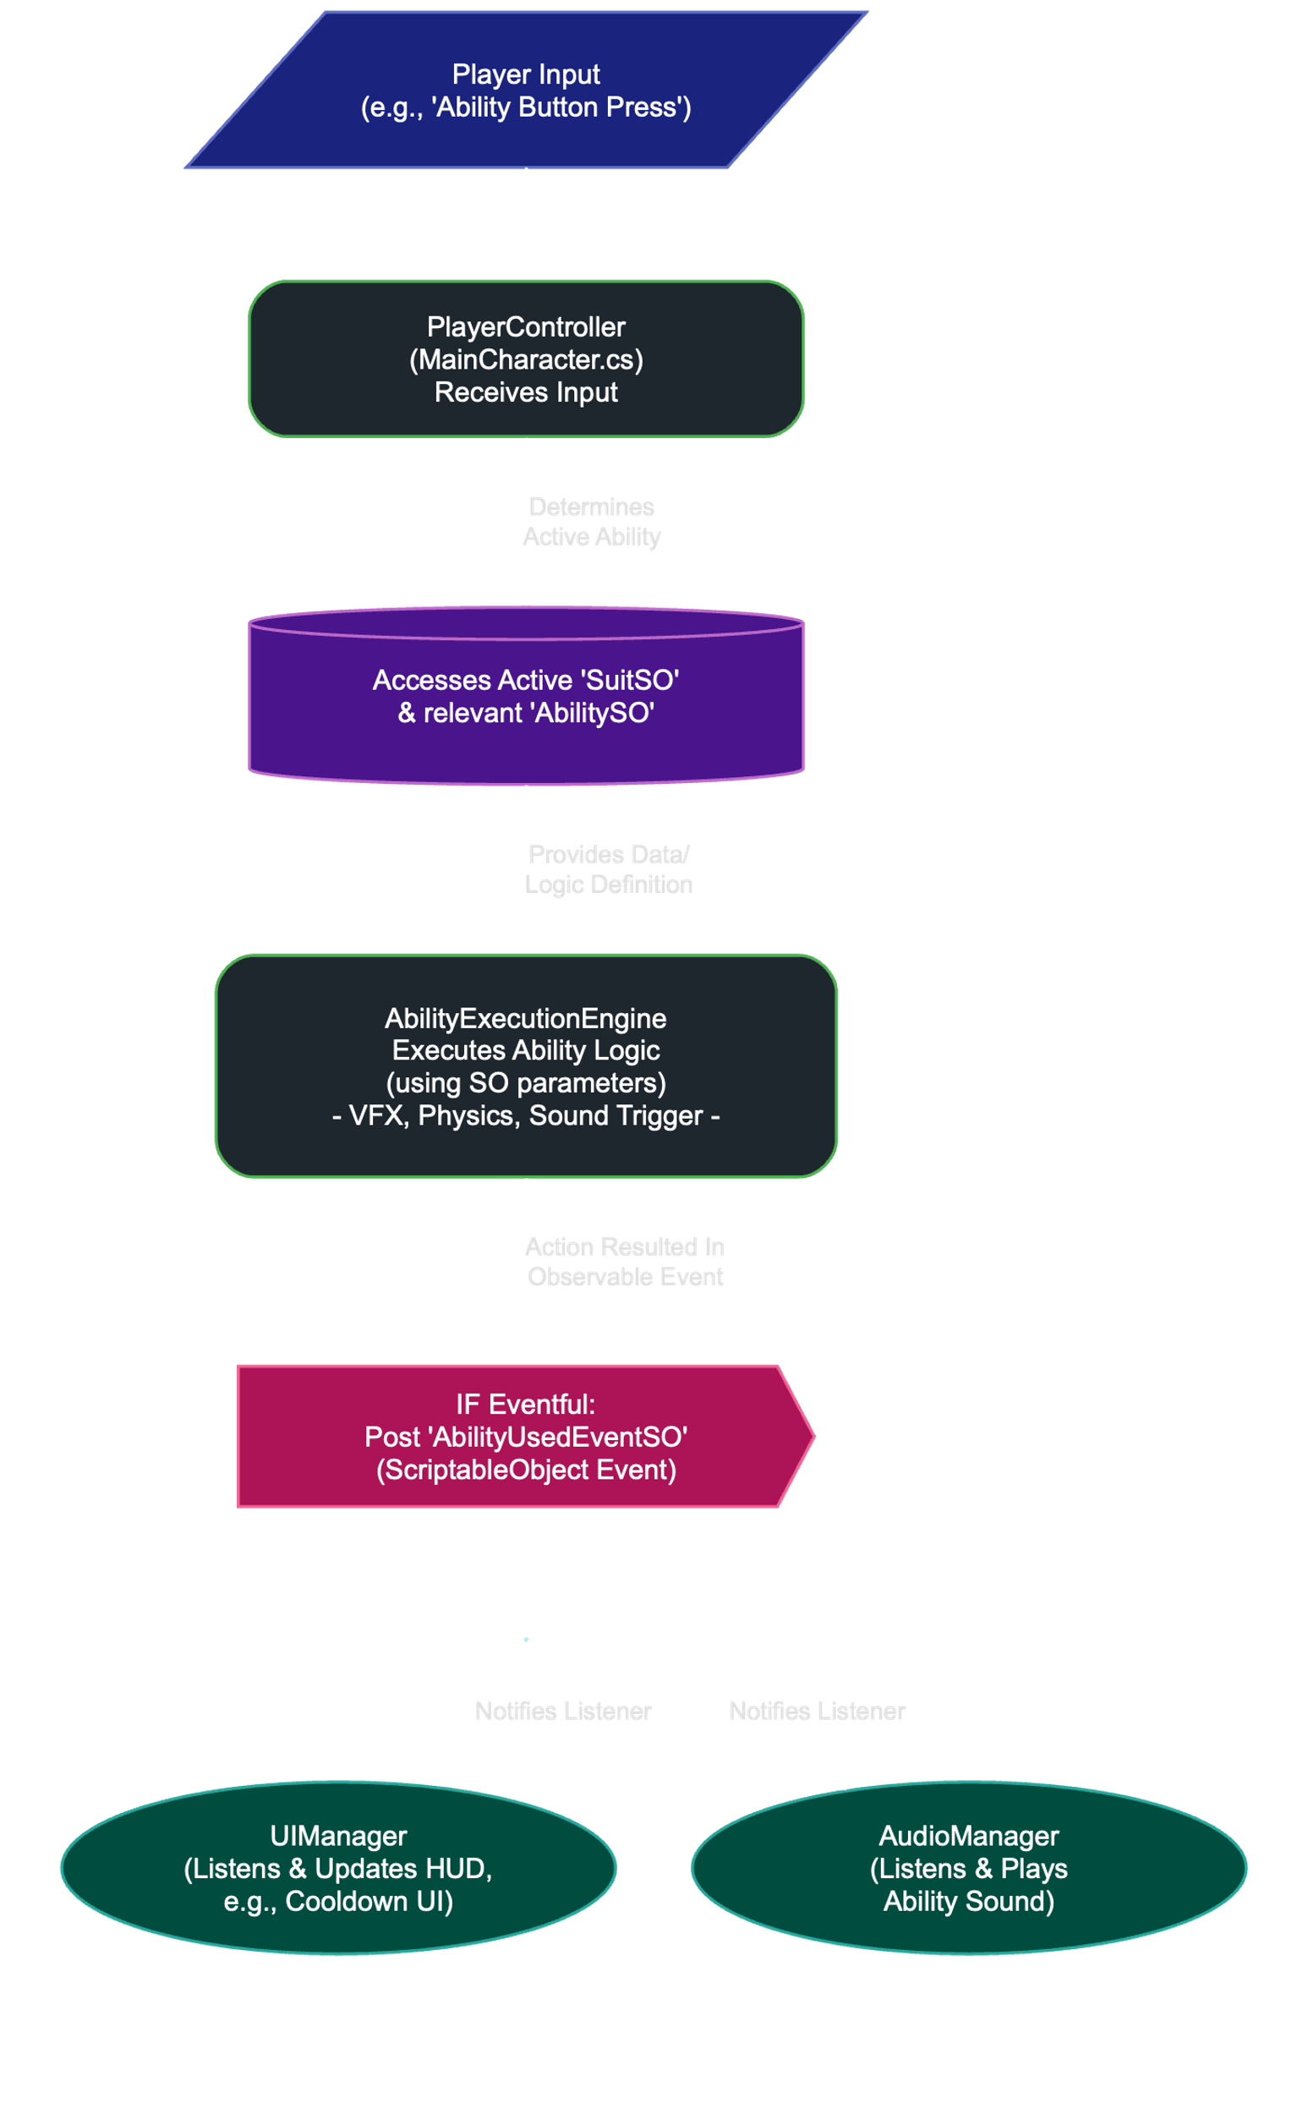
How We Solved It (Part 2): System Flow & Communication
#3: State Pattern (Enemy AI & Game Flow):
Enemies: Clear behavior states (idle, chase, attack).
Game: Defined states (menu, playing, paused).
Benefit: Organized, debuggable complex behaviors.
#4: Observer Pattern (SO Event Channels - "Notice Board"):
Event happens (player hit) -> posts "notice" (SO Event).
Other systems (UI, sound) react if interested. No direct links.
Benefit: Decoupled systems, cleaner code, maintainable.
Key Tech: URP (visuals), A* Pathfinding (enemy nav).
Notes:
Speaker Notes: (You'll deliver this verbally) Enemies and the game's flow use the State pattern, which keeps their behaviors organized. And for getting different systems to communicate, we used ScriptableObject Event Channels – it's like a digital notice board. When something happens, a notice gets posted, and any system that cares can react. This keeps everything nicely separated. Plus, URP helped us make the different 'mind-zones' look cool, and A* makes enemies chase you properly.

Slide 13
So, Did Our Plan Work?
Added 3 diverse powers; minimal core changes.
Smooth performance and game feel.
Decoupled system: easier debugging & additions.
[IMAGE/GIF: Short GIF showing off a few different cool powers in action]
Notes:
Speaker Notes: (You'll deliver this verbally) And yeah, this approach worked out pretty well! We were able to add a bunch of unique player abilities without massive headaches, the game runs smoothly, and because our code is organized, fixing things and adding features has been manageable.

Slide 14
The Coolest Part & What's Next
Proudest Of: Deep ideas linked to gameplay via flexible, data-driven design.
Future: More powers, crazier "demons," expanded world, finish story.
[IMAGE: An exciting in-game shot or a piece of concept art hinting at future areas]
Notes:
Speaker Notes: (You'll deliver this verbally) What we're most proud of is how the game's deep ideas are built right into the gameplay, thanks to our flexible, data-driven systems. For the future, we'd love to add more powers, crazier enemies, new areas of the mind-world to explore, and wrap up the story.

Slide 15
Questions?
Team: Naor, Majd, Daniel, Or [TEXT: Your Portfolio/Project Link (Optional)]
[IMAGE: "Shadow & Eye" logo]
Notes:
Speaker Notes: (You'll deliver this verbally) Thanks for listening! Any questions?

